Slide 1
www.csharp.org/tutorial1
Hello world
Methods
Web service
Routing
Deploy
This is the simplest C# program:
System.Console.WriteLine("hello world");
hello world
Try a different message, and see how the output changes to the right.
Here’s something a bit more advanced. It uses a variable called "i" which can hold any integer:
int i = 0;
while (i < 3)
{
System.Console.WriteLine("hip hooray");
i = i + 1;
}
i = 0
hip hooray, hip hooray, hip hooray
i=1, i=2, i=3
You can see it printed the message three times. Try making it print 10 tines. Try making
it print infinity times. Hint: while (true)
Download this app as a single-file native binary:
Windows
OSX
Linux
Docker

Slide 2
www.csharp.org/tutorial2
Hello world
Methods
Web service
Routing
Deploy
Let's separate out the code into building-blocks, known in code as "functions":
var txt = GetText();
System.Console.WriteLine(txt);
string GetText()
{
return "in a function plz send hlp";
}
txt = "in a function plz send hlp"
in a function plz send help
"in a function plz send help"
Try changing the name of the function to GetSampleText. You have to change both the
place where you invoke the function, and the place where you declare it. Try changing it to return an integer.
When we write a function, we always want to test what it's doing. Here's how:
[Fact]
void TestMyFunction()
{
var txt = GetText();
Assert.Equal(txt, "in a function");
}
txt = "in a function plz send hlp"
TEST FAILED
details
The tests in your code get run automatically while editing. This one failed. Can you fix it?
Download this app.
Windows
OSX
Linux
Docker

Slide 3
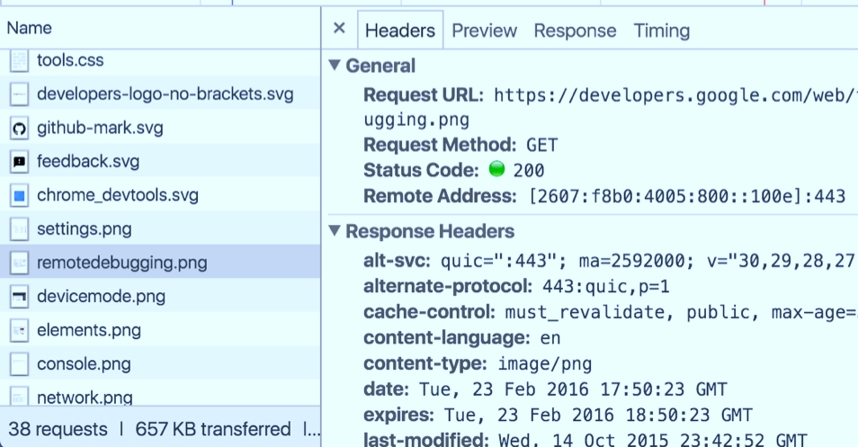


www.csharp.org/tutorial3
A web-service is just a program that listens for requests from browsers, and gives a response. Here's the simplest:
Hello world
Methods
Web service
Routing
Deploy
var listener = new WebHost(8080);
while (true)
{
var request = listener.WaitForNextRequest();
var response = new HttpReponseMessage();
response.StatusCode = HttpStatusCode.OK;
response.Content = new StringContent("hello!");
request.SendResponse(response);
}
[Fact]
void TestService()
{
listener.SendTestRequest("");
}
listener = {...}
request = {...}
response = {...}
response = {OK, ...}
response = {OK, "hello"}
Explore the headers that got sent in the test request, and the headers that came back.
Can you make it deliver a "404 not found" response instead?
Deploy this webservice:
Azure

Slide 4
www.csharp.org/tutorial4
Typically your web-service will handle lots of different URLs. You could try to parse the
request URL yourself, but it's much easier to use attribute routing:
Hello world
Methods
Web service
Routing
Deploy
var listener = new WebHost(8080);
while (true)
{
var request = listener.WaitForNextRequest();
var route = RouteRequest(request);
route.Dispatch();
}
[Route("users/{userId}/orders"), HttpGet]
HttpResponseMessage GetOrders(int userId)
{
var response = new HttpResponseMessage();
response.Content = new StringContent(
$"These are the orders for {userId}");
return response;
}
listener = {...}
request = {"users/123/orders"}
route = {GotOrders, userId=123}
response = {...}
response = {"These are the orders..."}
Try adding an additional route to handle users/userid/profile, and test it.
Try a malformed test with a non-integral userId - how does this get routed?
Deploy this webservice:
Azure

Slide 5
www.csharp.org/tutorial4
Typically your web-service will handle lots of different URLs. You could try to parse the
request URL yourself, but it's much easier to use attribute routing:
Hello world
Methods
Web service
Routing
Deploy
var listener = new WebHost(8080);
while (true)
{
var request = listener.WaitForNextRequest();
var route = RouteRequest(request);
route.Dispatch();
}
[Route("users/{userId}/orders"), HttpGet]
HttpResponseMessage GetOrders(int userId)
{
var response = new HttpResponseMessage();
response.Content = new StringContent(
$"These are the orders for {userId}");
return response;
}
listener = {...}
request = {"users/123/orders"}
route = {GotOrders, userId=123}
response = {...}
response = {"These are the orders..."}
Deploy webservice
Please sign in with your Microsoft Account.
Your webservice will be hosted in Azure under your name.
It will remain completely private to you (until you're ready to publish it). This is all free!
OK
CANCEL
Try adding an additional route to handle users/userid/profile, and test it.
Try a malformed test with a non-integral userId - how does this get routed?
Deploy this webservice:
Azure

Slide 6
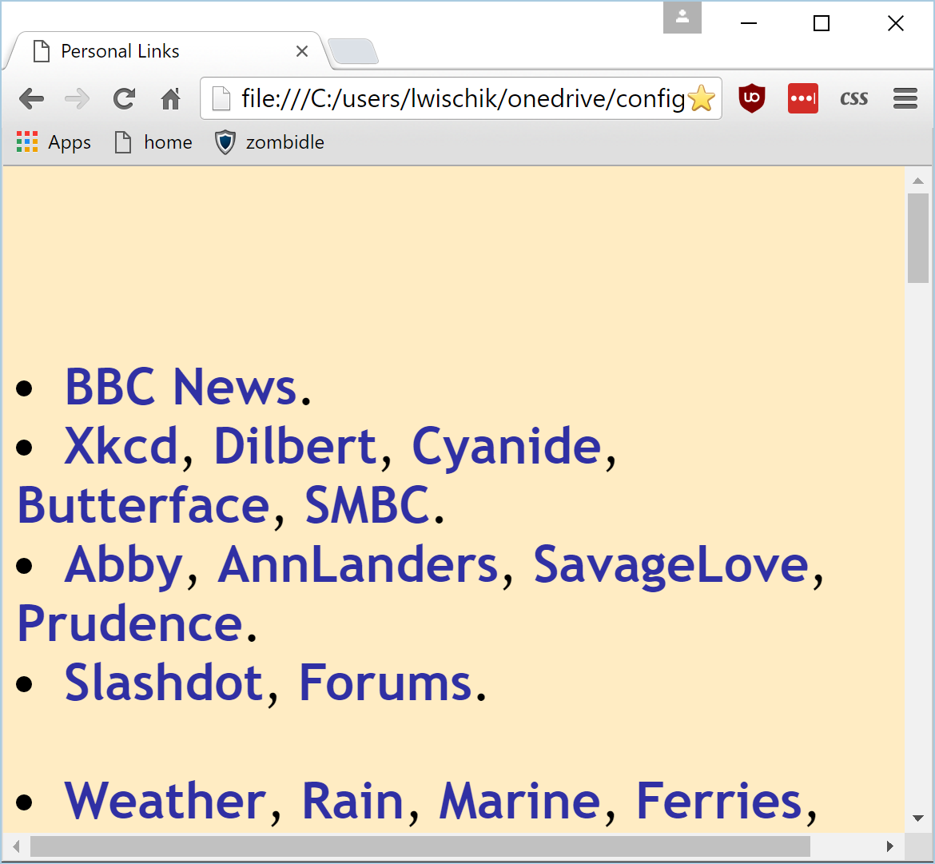
www.c#.org/ljw1004/WebService1/
var listener = new WebHost(8080);
while (true)
{
var request = listener.WaitForNextRequest();
var route = RouteRequest(request);
route.Dispatch();
}
[Route("users/{userId}/orders"), HttpGet]
HttpResponseMessage GetOrders(int userId)
{
var response = new HttpResponseMessage();
response.Content = new StringContent(
$"These are the orders for {userId}");
return response;
}
listener = {http://ljw1004.azure/}
Main.csx
request = {"users/123/orders"}
route = {GotOrders, userId=123}
http://ljw1004.azure/users/{userId}/or..
response = {...}
response = {"These are the orders..."}
TOOLBOX:
rest point
json
database
auth
bing search
bing maps
logging
custom 404
publish
PROJECT:
open in VSCode
open in VS

Slide 7
www.c#.org/ljw1004/WebService1/
var listener = new WebHost(8080);
while (true)
{
var request = listener.WaitForNextRequest();
var route = RouteRequest(request);
route.Dispatch();
}
[Route("users/{userId}/orders"), HttpGet]
HttpResponseMessage GetOrders(int userId)
{
var response = new HttpResponseMessage();
response.Content = new StringContent(
$"These are the orders for {userId}");
return response;
}
[Fact, AutoRun]
async void TestService()
{
var http = new HttpClient();
await http.GetStringAsync("http://ljw1004.az/");
}
listener = {http://ljw1004.azure/}
Main.csx
request = {"users/123/orders"}
route = {GotOrders, userId=123}
http://ljw1004.azure/users/{userId}/or..
response = {...}
response = {"These are the orders..."}
TOOLBOX:
rest point
json
database
auth
bing search
bing maps
logging
custom 404
publish
PROJECT:
open in VSCode
open in VS

